Slide 1
2023-06-01
Software project management
王文静 202230310283
潘佳琪 202230310280
陈明辉 202230310243
Cinema ticketing system based on Node.js

Slide 2
CONTENTS
introduction
System implementation
Risk/Test Plan
Organization chart
Project lifetime
Project cost control and Gantt charts

Slide 3
01
Introduction

Slide 4
Introduction
The goal of this project was to develop a simple cinema ticketing system. The management and service mechanism of the cinema market requires gradual intelligence, but the traditional cinema ticket purchase method in the past can no longer meet everyone's requirements, which requires a new way to purchase tickets - online ticket purchase, to relieve the pressure of peak periods, and provide users with convenient and fast ticket purchase.
Starting from market demand and the status quo of cinema information service management, on the basis of the analysis of WeChat developer tools and MySQL relational database management system, we select lightweight and efficient Node.js and WeChat developer tools to implement front-end and back-end data request response and MySQL service background database to design, and design a set of online ticketing service system according to the design process of overall architecture, user interface design and database design.

Slide 5
02
System implementation

Slide 6
Introduction to the tool
WeChat Developer Work is a development tool for WeChat Mini Programs officially provided by WeChat, which concentrates development, debugging, preview, upload and other functions. New developer tools help developers develop WeChat mini programs simply and efficiently
Node.js is a JavaScript runtime environment based on the Chrome V8 engine, using an event-driven, non-blocking I/O model that lets JavaScript run on an open platform on the server side.
MySQL is an open source relational database management system (RDBMS), MySQL database system uses the most commonly used database management language - Structured Query Language (SQL) for database management.

Slide 7
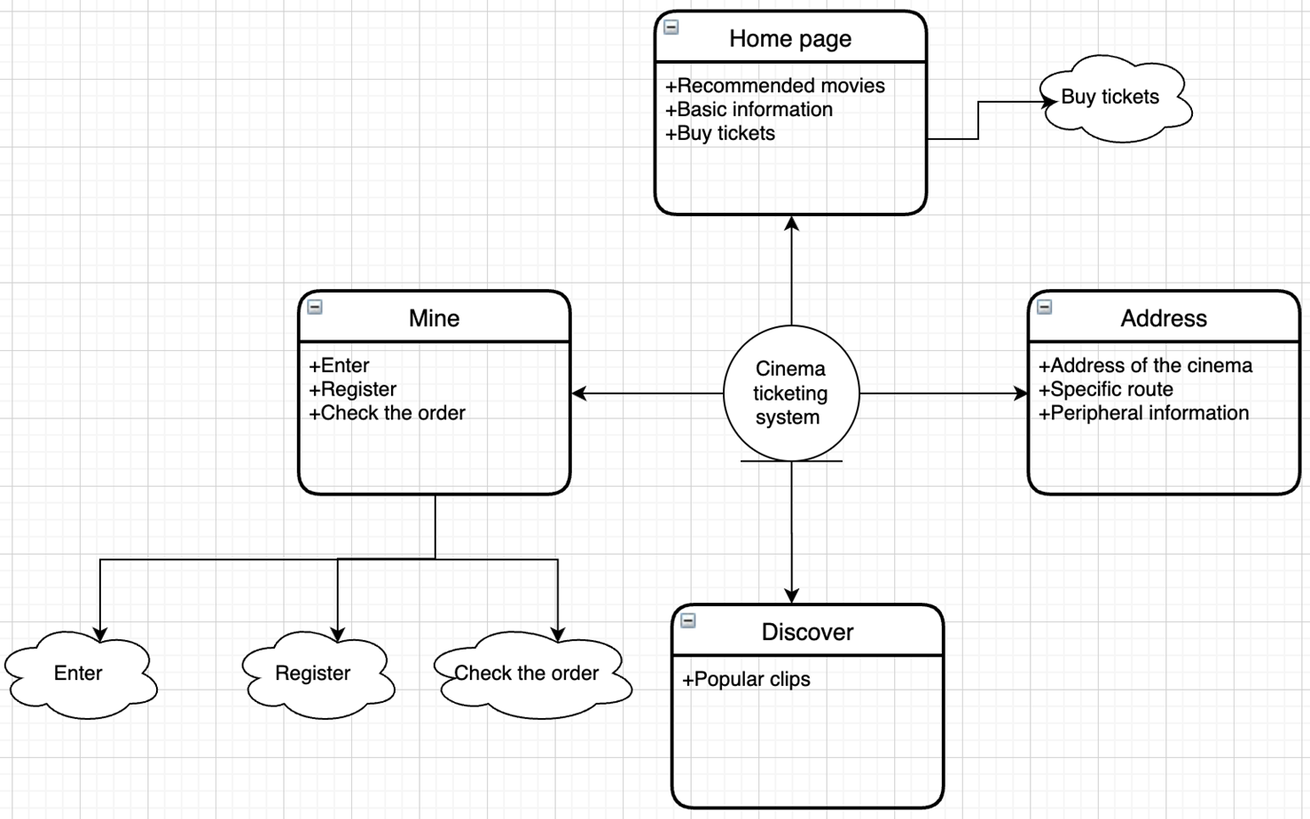
Functional modules
The functional modules of the system are mainly divided into four parts: home, address, discovery, and mine

Slide 8
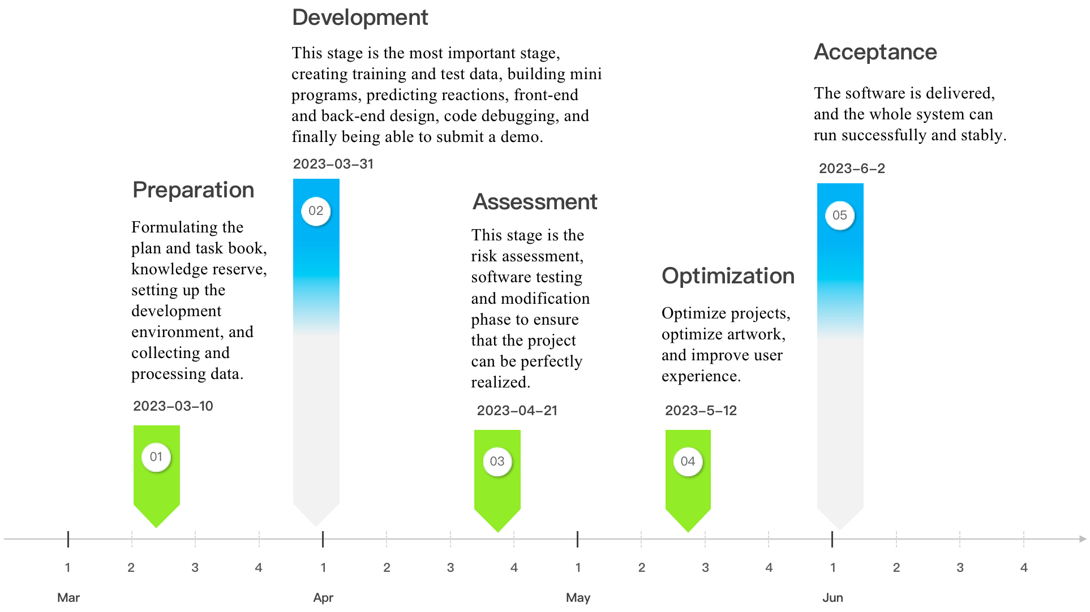
Milestone

Slide 9
03
Organization chart

Slide 10
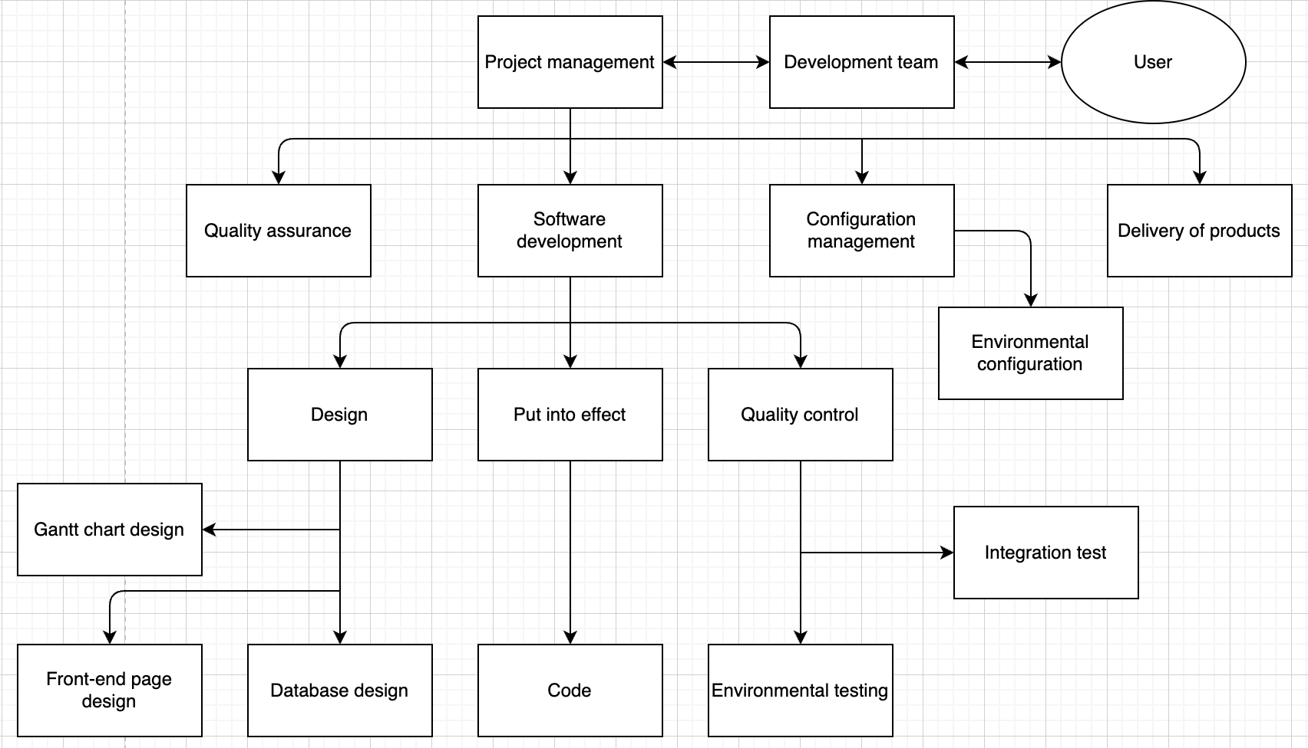
Organization chart

Slide 11
04
Project lifetime

Slide 12
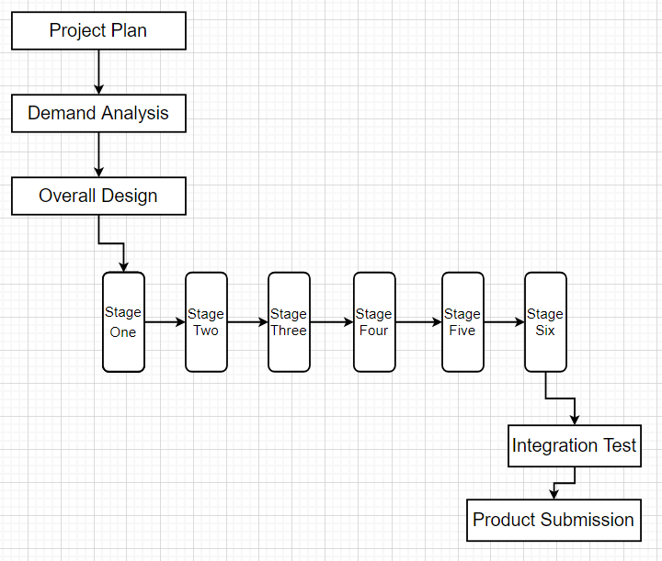
Project Lifetime

Slide 13
Project lifetime
The phases in the lifetime are defined as follows:
Project planning phase
Project Objectives: Determine the scale, timeline and resource requirements of the project according to the project proposal and preliminary needs analysis
Process: project planning, plan confirmation
Requirements analysis phase
Phase goal: Determine the customer's needs
Process: requirements acquisition, requirements analysis, requirements control
Design phase
Stage goal: overall system structure design
Process: Overall design
Phase 1 implementation
Phase goal: Realize the basic configuration of the system
Process: node.js, MySQL, Visual Studio Code environment setup and program installation, and ID registration of WeChat developer tools

Slide 14
Project lifetime
Phase 2 implementation
Stage goal: to realize the construction of the basic page of the front-end of the Mini Program
Process: Create the basic framework of the four pages of Home, Theater, Discovery, and Me, as well as the display of relevant information such as movie information, scene arrangement and other related information on the homepage page and the basic layout of My Page
Phase 3 implementation
Stage goal: Database table creation
Procedure: Create a user information table and a movie table, and add user information and movie ticket information
Phase 4 implementation
Stage goal: Build a local server
Process: Use Visual Studio Code to set up a local server and connect to the database so that it can access videos, access images, and set up listening interfaces

Slide 15
Project lifetime
Phase 5 implementation
Stage goal: Improve the layout of the Mini Program page
Process: Realize the login registration and order viewing function of my page, the ticket purchase function of the home page, and the video playback function of the discovery page
Phase 6 implementation
Stage goal: Realize the function of mini program theater address
Process: Transmit the latitude and longitude of the destination to Tencent Maps, call the Tencent Maps API to obtain the current geographic location information, and return it
Integration test
Phase goal: to pass software testing in an integrated environment
Process: integration test, system test
Product Submission
Stage goal: the product can be put into use
Process: Product submission

Slide 16
05
Risk/Test Plan

Slide 17
Risk Plan
No. | Risk events | Possibility | Effect | Countermeasure
1 | Not enough time for product development | 60% | 50% | 1. Take an overtime approach 2. Modify the plan 3. Remove some tasks 4. Discuss with the customer to extend some time
2 | There are no test cases that fit your needs | 20% | 20% | Modular development, each function is tested individually
3 | Insufficient technical support | 30% | 10% | 1.Train developers 2.Look for technical guidance 3.Take a development and learning approach, requiring them to master the technology within a specified time
4 | Uncertain demand leads to a change in demand | 80% | 20% | If there is a place that needs to be revised, the place where it should be revised should be communicated and discussed in a timely manner.
5 | Risk of secondary outbreaks | 60% | 20% | Be ready to switch to online collaborative development at any time, do a good job of psychological construction of team members, and communicate and understand each other
6 | HR risk | 50% | 20% | 1. Carry out targeted training 2. Arrange the right people to the right positions

Slide 18
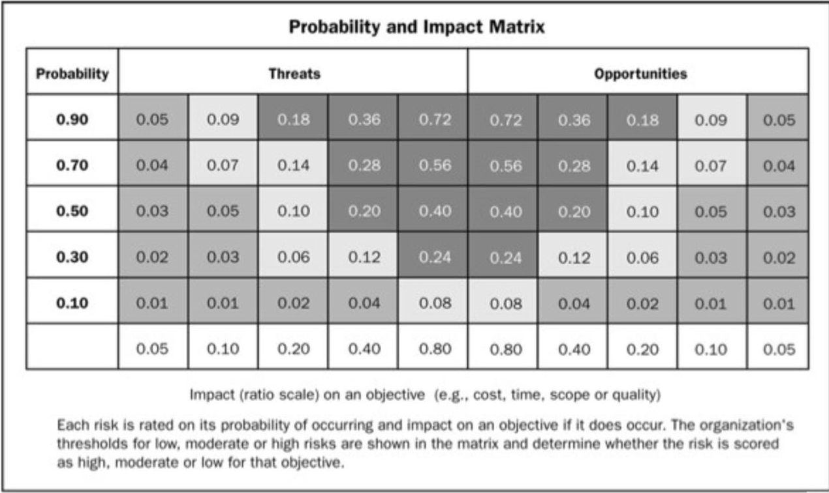
Risk Plan
1.Not enough time for product development
2.There are no test cases that fit your needs
3.Insufficient technical support
4.Uncertain demand leads to a change in demand
5.Risk of secondary outbreaks
6.HR risk

Slide 19
Test plan
The testing phase is the key stage to ensure the quality of the project's software, and is the final check of the software design and coding. The purpose is to first determine that the software developed is wrong, and the key is to find out what is wrong, not to prove that the program is correct. Testing is an important part of the overall project work, so in order to test well, it is necessary to write a complete test plan. Test plans often wait until late in the development cycle to start and need to allow enough time for effective execution.
Evaluation Criteria:
Test whether the functions completed by each module and window are accurate, whether the data is correct, and whether the operation is simple and convenient
Whether the correct data can be returned according to the expected answer, whether the wrong input data can be recognized, and the correct information prompt can be given
Each module allows for one error and more than one error, which requires re-modification of the code.

Slide 20
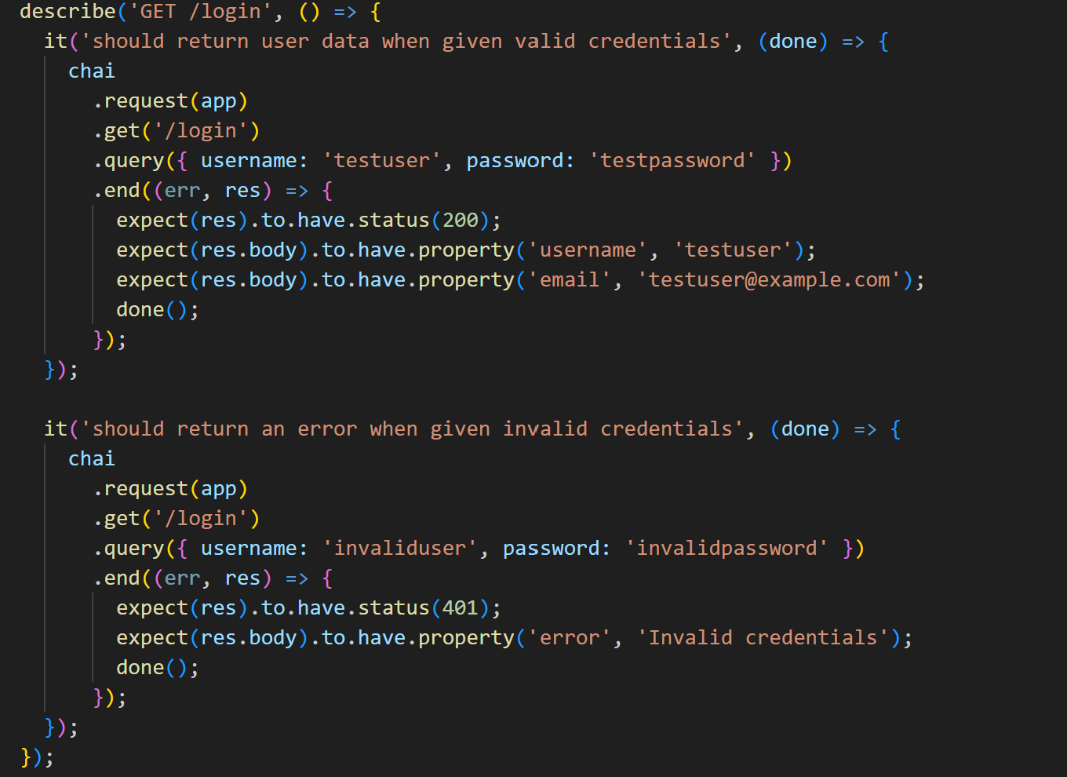
Test plan
The project uses Mocha and Chai, two common testing frameworks for Node .js
Example of test cases:

Slide 21
Test plan
illustration
Login for the test:
When a valid user name and password are provided, the test ensures that the application can return data for the appropriate user, such as the user name and email address.
When an invalid user name and password are provided, the test ensures that the application is able to return an error response with an appropriate error message indicating that the credentials are invalid.
Register for the test:
When a new user name, password, is provided, the test ensures that the application can create a new user and return data for the corresponding user, such as the user name, and so on.

Slide 22
06
Project cost control and Gantt chart

Slide 23
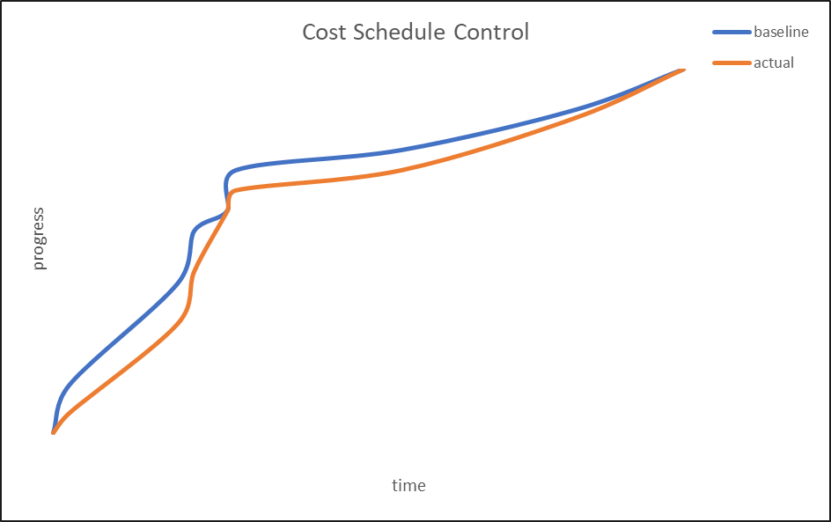
Cost control
We can now see the current status versus the planned status which shows the actual progress curve to be below the planned curve.

Slide 24
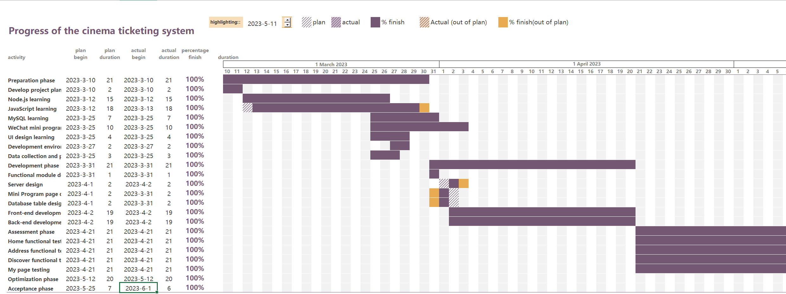
Gantt chart

Slide 25
THE END
THANKS

